Slide 1

Predictive Maintenance

Slide 2

Team:
Sri Narasimha
Hritik
Mayuri Gangadhar
Omkar
Karnakar
Teista

Slide 3

What is Predictive Maintenance?
Proactive Approach
Data-Driven Insights
Predictive maintenance is a proactive approach to asset management that uses data and analytics to anticipate potential equipment failures.
It leverages data collected from sensors, historical maintenance records, and other sources to identify patterns and predict future failures.

Slide 4

The Importance of Predictive Maintenance
1
Reduced Downtime
2
Lower Maintenance Costs
By predicting failures, predictive maintenance minimizes downtime, ensuring uninterrupted operations and maximum productivity.
It helps optimize maintenance schedules, reducing unnecessary repairs and maximizing the lifespan of assets.
3
Improved Safety
By identifying potential hazards, predictive maintenance improves safety for workers and the overall operation.

Slide 5
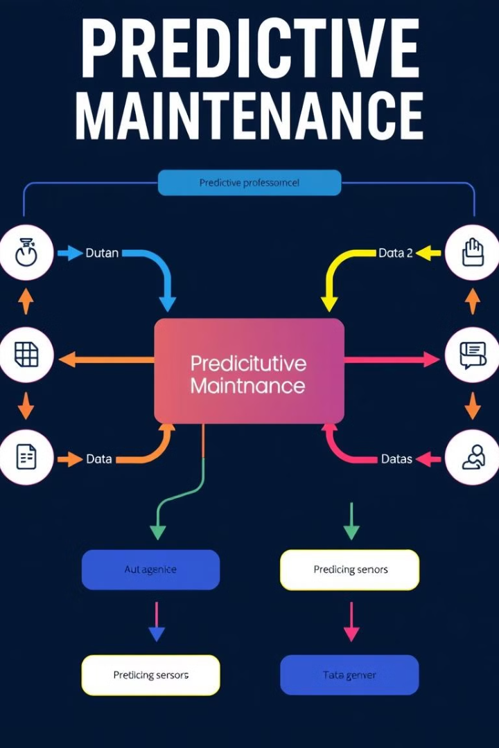
Key Components of a Predictive Maintenance System
Data Acquisition
Data Preprocessing
Collecting data from sensors, historical records, and other relevant sources.
Cleaning, transforming, and preparing data for analysis.
Predictive Modeling
Alerting and Reporting
Developing and training machine learning algorithms to predict failures.
Generating alerts and reports to notify stakeholders about potential failures and maintenance needs.

Slide 6




Data Collection and Analysis
Sensor Data
Historical Data
Sensors collect real-time data on equipment performance, including vibration, temperature, and pressure.
Past maintenance records, repair history, and equipment specifications provide valuable insights.
Environmental Data
Factors like temperature, humidity, and air quality can influence equipment performance.

Slide 7
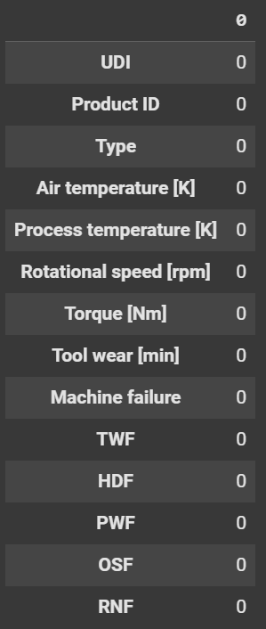
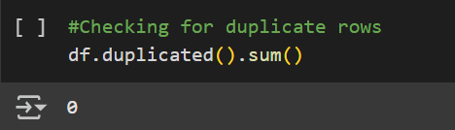
Exploratory Data Analysis
1.No Missing Value
22.No Duplicate Found
Notes:
Data cleaning is a crucial first step in exploratory data analysis. This involves removing errors, inconsistencies, and outliers from the dataset to ensure the data is accurate and reliable. Data transformation is about converting the data into formats that are suitable for analysis. This could involve tasks like changing data types, handling missing values, or restructuring the data. Feature engineering is the process of creating new features from the existing data. This allows us to extract more meaningful information and improve the performance of our models. These three steps - data cleaning, data transformation, and feature engineering - form the foundation of exploratory data analysis. They help us prepare the data and uncover valuable insights that can inform our analysis and decision-making.

Slide 8
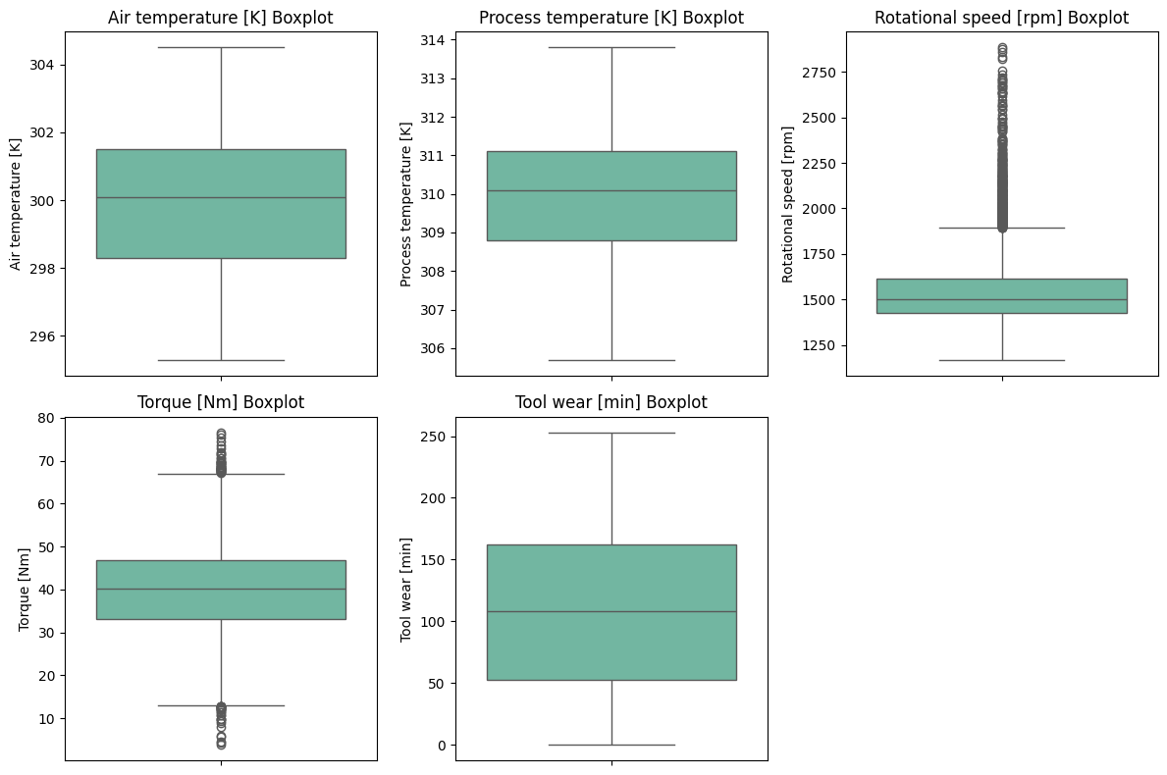
3.Handling Outliers
Before

Slide 9
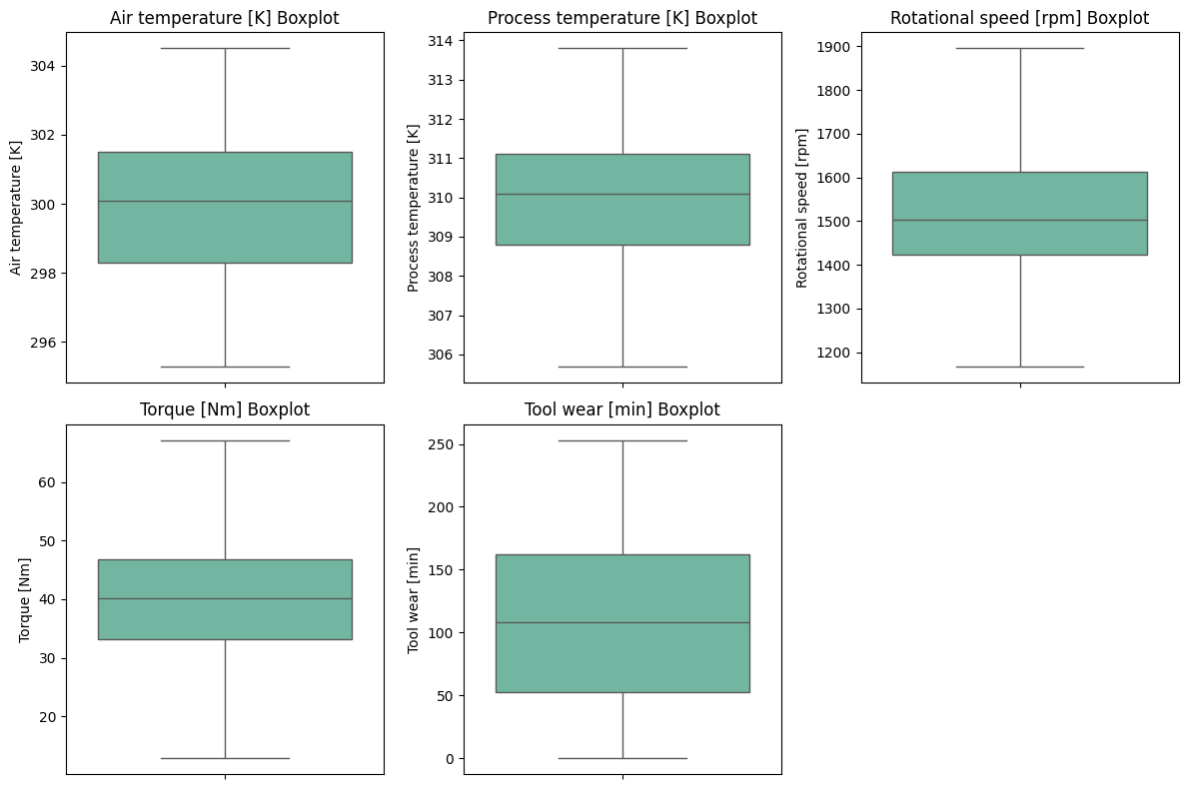
After

Slide 10

Machine Learning and Predictive Algorithms
Model | Precision (0) | Recall (0) | F1-Score (0) | Precision (1) | Recall (1) | F1-Score (1) | Accuracy | Macro Avg (F1) | Weighted Avg (F1)
Logistic Regression | 1.00 | 1.00 | 1.00 | 1.00 | 0.95 | 0.97 | 1.00 | 0.99 | 1.00
Random Forest | 1.00 | 1.00 | 1.00 | 1.00 | 0.97 | 0.98 | 1.00 | 0.99 | 1.00
Decision Tree | 1.00 | 1.00 | 1.00 | 1.00 | 0.97 | 0.98 | 1.00 | 0.99 | 1.00
Gradient Boosting | 1.00 | 1.00 | 1.00 | 0.91 | 0.97 | 0.94 | 1.00 | 0.97 | 1.00
Support Vector Machine | 1.00 | 1.00 | 1.00 | 1.00 | 0.97 | 0.98 | 1.00 | 0.99 | 1.00

Slide 11
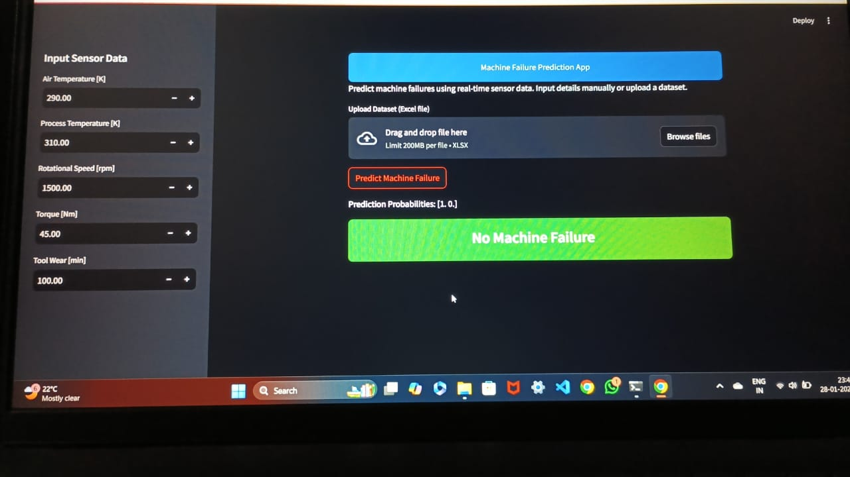
Deploying the Predictive Maintenance Model and Final Output:
.
.

Slide 12
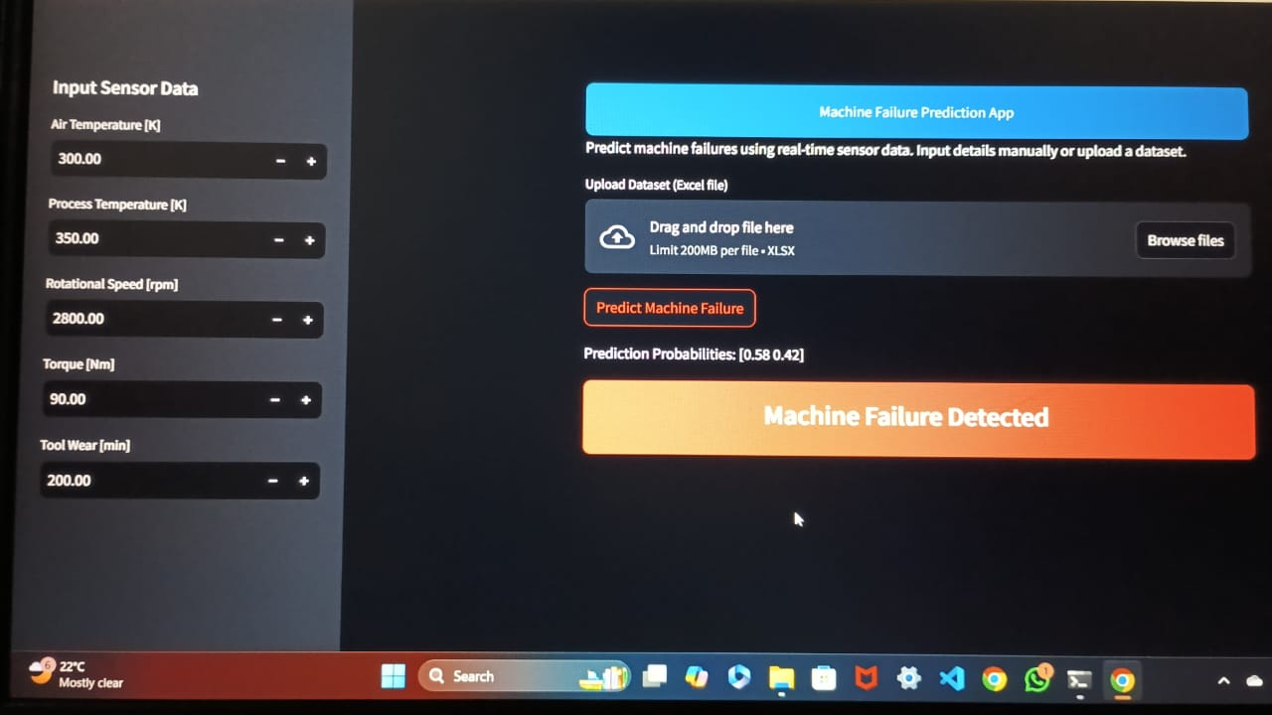

Slide 13



Case Studies: Successful Predictive Maintenance Deployments
Manufacturing
1
Predicting machine breakdowns and optimizing production lines.
Energy
2
Monitoring turbines and wind farms for potential failures.
Transportation
3
Predicting train derailments and optimizing maintenance schedules for vehicles.

Slide 14

The Future of Predictive Maintenance: Trends and Innovations
Artificial Intelligence (AI)
AI will improve failure prediction and anomaly detection using deep learning and Digital Twins.
Internet of Things (IoT)
More sensors and edge computing will improve data collection and real-time monitoring, leading to faster responses and less downtime.
Advanced Predictive Analytics
Predictive models will be more accurate by using extra data like weather and operator actions. Explainable AI will make the predictions easier to trust.
Digital Twins
Virtual models of equipment will help optimize maintenance and allow proact

Slide 15

Faced challenges :
One of the key challenges has been the complexity of the equipment and systems we're trying to monitor and predict failures for. These are highly sophisticated, interconnected systems that generate massive amounts of data.
Collecting, organizing, and making sense of all that data has been a major hurdle. We've had to develop advanced analytics and machine learning capabilities to extract meaningful insights.
Another big challenge has been integrating the predictive maintenance system with our existing maintenance workflows and processes. Getting everyone on board and changing established practices has required a lot of change management.
Ensuring the accuracy and reliability of the failure predictions has also been critical. We've had to fine-tune the models and validate the results to build trust in the system.
Finally, the costs and resource requirements for implementing and operating the predictive maintenance system have been substantial. Securing the necessary budget and staffing has been an ongoing challenge.
Notes:
The predictive maintenance project has faced a number of significant challenges that we've had to overcome. One of the key challenges has been the complexity of the equipment and systems we're trying to monitor and predict failures for. These are highly sophisticated, interconnected systems that generate massive amounts of data. Collecting, organizing, and making sense of all that data has been a major hurdle. We've had to develop advanced analytics and machine learning capabilities to extract meaningful insights. Another big challenge has been integrating the predictive maintenance system with our existing maintenance workflows and processes. Getting everyone on board and changing established practices has required a lot of change management. Ensuring the accuracy and reliability of the failure predictions has also been critical. We've had to fine-tune the models and validate the results to build trust in the system. Finally, the costs and resource requirements for implementing and operating the predictive maintenance system have been substantial. Securing the necessary budget and staffing has been an ongoing challenge.

Slide 16

Conclusion:
The predictive maintenance project successfully demonstrated the potential of leveraging data science to enhance operational efficiency, reduce downtime, and optimize maintenance costs. By analyzing historical equipment data, identifying key features, and applying advanced machine learning models, we were able to predict equipment failures with a high degree of accuracy.
Key achievements include:
Failure Prediction: Early detection of potential failures, enabling timely interventions.
Cost Optimization: Reduction in maintenance costs by avoiding unnecessary repairs and unplanned downtimes.
Efficiency Improvements: Enhanced operational efficiency and asset utiliz

